Slide 1
FACE ANTI- SPOOFING SYSTEM
-AMJAD HUSSAIN
-S3 MCA
INTERNAL GUIDE: Prof. Vaheetha Salam

Slide 2
INTRODUCTION
The increasing integration of facial recognition technology into various applications has raised concerns about potential vulnerabilities to spoofing attacks.
This project presents an innovative Face Anti-Spoofing System (FASS) implemented in Python, leveraging the power of Face Recognition.
FASS aims to enhance the security and reliability of facial recognition systems by distinguishing between genuine human faces and spoofed representations, such as photos or videos.

Slide 3
RELATED WORKS
SI NO | NAME | PROS | CONS
1 | A Survey on Face Anti-Spoofing Algorithms, Meigui Zhang, Kehui Zen and Jinwei Wang, Journal of Information Hiding and Privacy Protection, Tech Science Press | The paper seems to provide a comprehensive overview of the evolution of face anti-spoofing methods, including manual feature extraction and deep learning approaches. It acknowledges important challenges in face anti-spoofing, such as dealing with database size impact on accuracy and enhancing the generalization ability for detecting unknown spoofing. | Paper discusses the effectiveness and state-of-the-art results of face anti-spoofing methods and doesn’t ideally provide information about the datasets used and the experimental setup.

Slide 4
RELATED WORKS
SI NO | NAME | PROS | CONS
2 | A simple and effective patch-Based method for frame-level face anti-spoofing, Shengjie Chena, Gang Wua, Yujiu Yang b, Zhenhua Guo b Elsevier, 2023 | Discusses about: A frame-level method that is trained with randomly cropped patches from face images. Different crop strategies are used in training and inference, which has not been explored in previous studies. Spatial and channel attention mechanisms are used to obtain important information for face liveness detection. Experimental results show that both attention mechanisms are effective. The use of ResNet18 as the basic framework of the network, which has been proven to be effective in multiple vision tasks. | The use of only RGB and IR images, which may limit the generalization ability of the method to other modalities. The lack of data augmentation techniques, which may affect the robustness of the method to variations in pose, illumination, and other factors. The limited size of existing face liveness detection databases, which may affect the performance of the method on new datasets. The need for different patch sizes in the training and inference stages, which may complicate the implementation of the method in practical applications.

Slide 5
RELATED WORKS
SI NO | NAME | PROS | CONS
3 | Learning Deep Models for Face Anti-Spoofing: Binary or Auxiliary Supervision, Yaojie Liu, Amin Jourabloo, Xiaoming Liu Conference on Computer Vision and Pattern Recognition IEEE, 2018 | Introduces a new face anti-spoofing database, called the Oulu-NPU database, which contains a wide range of variables, including different illumination conditions, poses, and expressions. They use this database to train and evaluate their proposed CNN-RNN model, as well as several other state-of-the-art face anti-spoofing methods. | 1. Vulnerability to Adversarial Attacks 2. Data Dependence 3. Computational Complexity 4. Lack of Interpretability 5. Environmental and Scenario Dependency

Slide 6
ALGORITHMS MENTIONED
Convolutional Neural Networks (CNN) - extract discriminative features from raw images or videos.
Recurrent Neural Networks (RNN) - model the temporal dynamics of facial movements and expressions.
Long Short-Term Memory (LSTM) - capture the sequential dependencies between frames.
Autoencoder (AE) - learn a compressed representation of the input data.
Generative Adversarial Networks (GAN) - generate realistic fake faces that can be used to augment the training data.
Siamese Networks - compare two images or videos and determine whether they belong to the same person or not.

Slide 7
GAPS IDENTIFIED
Lack of standard datasets: There is a lack of standard datasets for face anti-spoofing, which makes it difficult to compare different algorithms and evaluate their performance objectively.
Limited generalization capability: Many existing algorithms have limited generalization capability, which means that they may not perform well on unseen data or in different scenarios.
Adversarial attacks: Deep learning-based algorithms may be vulnerable to adversarial attacks, which means that small perturbations in the input can cause misclassification.
Real-time processing: Many practical applications of face anti-spoofing require real-time processing, which imposes additional constraints on the algorithm design and implementation.

Slide 8
PROBLEM STATEMENT
The goal of this project is to develop an effective anti-face spoofing system using MobileNet, a lightweight and efficient convolutional neural network architecture.
The system aims to distinguish between genuine facial features and deceptive attempts, such as printed photos or video playback, in order to enhance the robustness of facial authentication methods.

Slide 9
OBJECTIVES
Collect a diverse dataset containing both genuine facial images and spoofed images to train and evaluate the anti-spoofing system.
Preprocess the collected data, including resizing images, normalizing pixel values, and augmenting the dataset to improve model generalization.
Implement a Haar Cascade Classifier for real-time face detection to identify regions of interest (faces) in input video frames.
Utilize MobileNet as a feature extractor to capture discriminative features from the detected face regions.
Integrate the trained anti-spoofing model into a real-time processing pipeline to analyze video frames and make predictions in real-time.

Slide 10
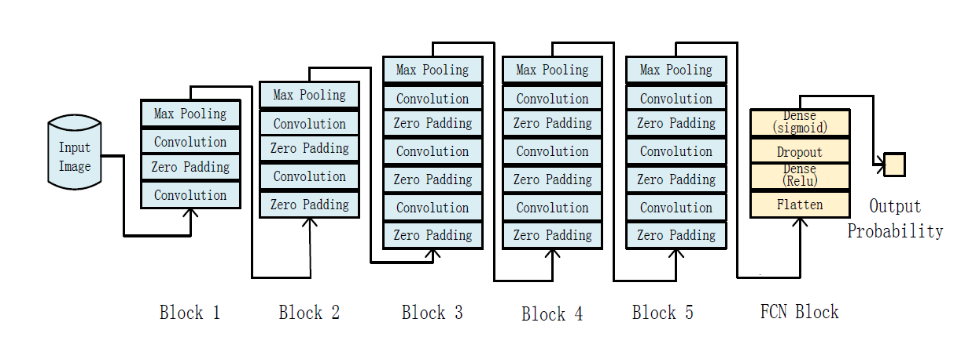
ARCHITECTURE OF CNN

Slide 11
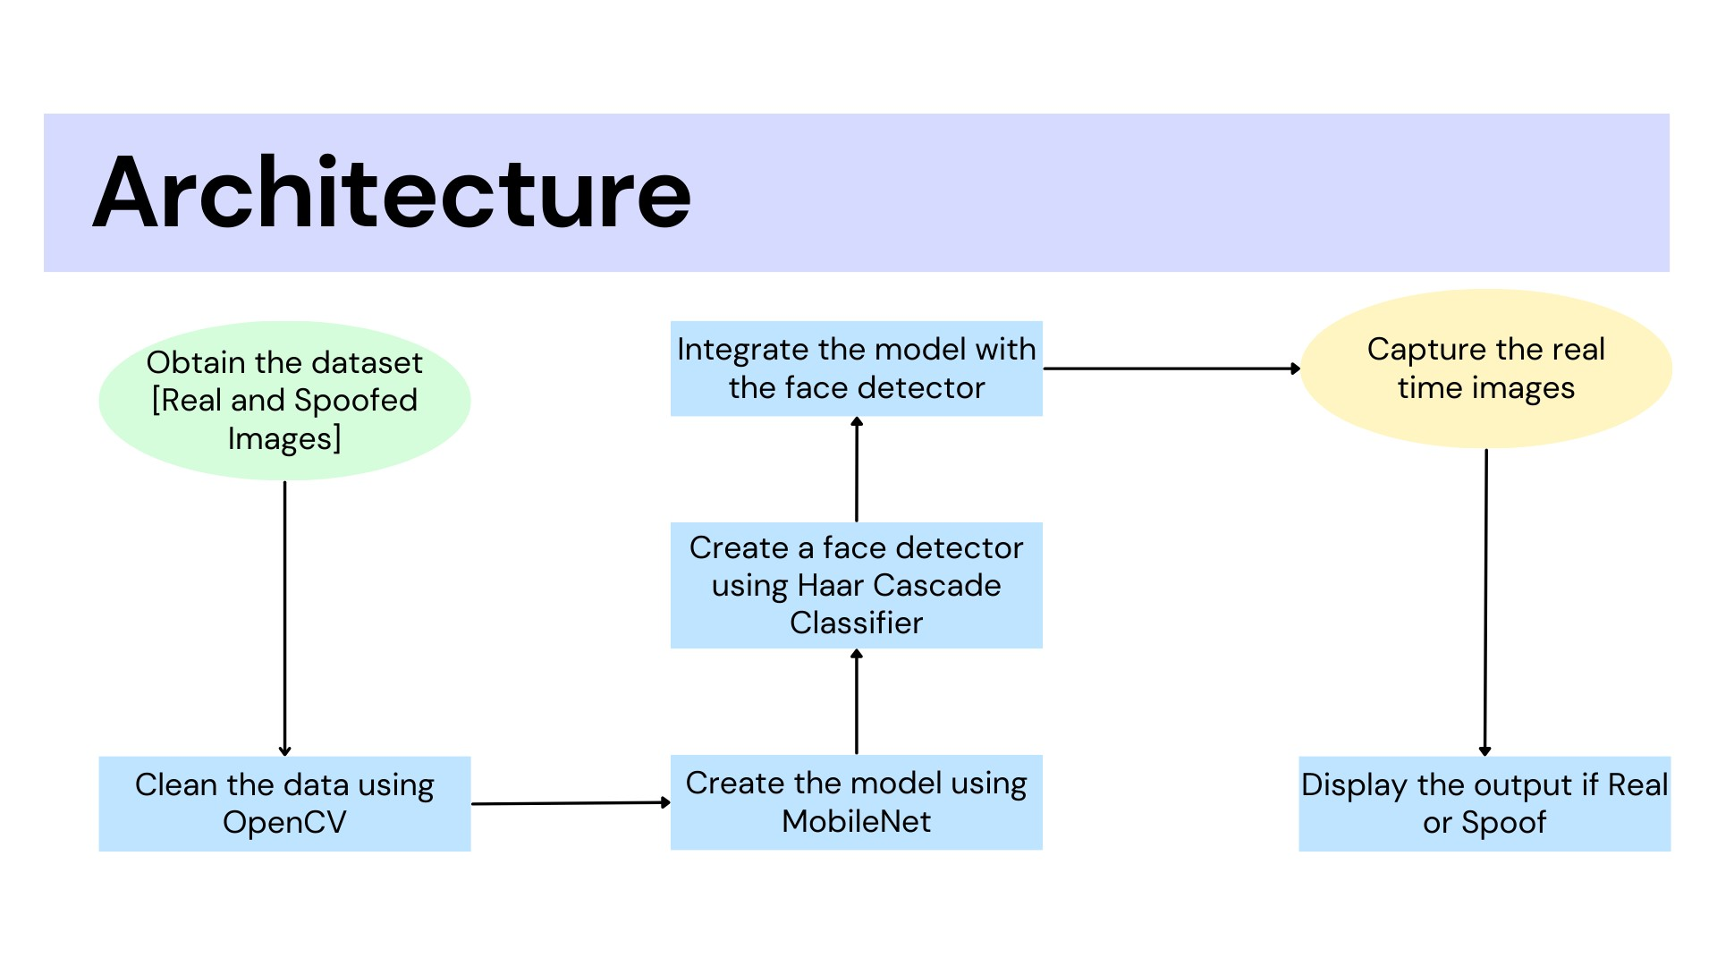

Slide 12
MOBILENET
MobileNet refers to a family of neural network architectures designed for mobile and edge devices with resource constraints. The original MobileNet, often referred to as MobileNetV1, was introduced by Google researchers in 2017. The primary goal of MobileNet is to provide a lightweight and efficient solution for computer vision tasks, such as image classification and object detection, on devices with limited computational resources.
Features:
Depth wise Separable Convolutions
Width Multiplier and Resolution Multiplier
Efficient Design
Global Average Pooling

Slide 13
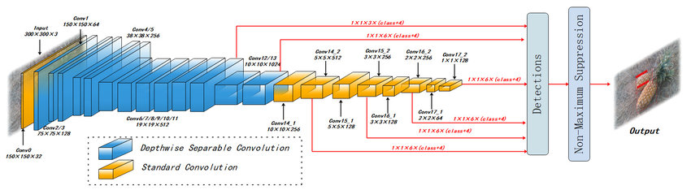
MOBILENET ARCHITECTURE

Slide 14
WHY MOBILENET?
Computational Efficiency
Low Model Size
Real-time Performance
Transfer Learning Capability
Good Generalization
Fast Inference Speed
Ease of Deployment
Adaptability to Limited Webcam Quality

Slide 15
HAAR CASCADE FACE CLASSIFIER
It is a machine learning object detection method used to identify objects in images or video. It is particularly well-suited for detecting faces. This technique is based on the Haar wavelet analysis, which involves analyzing patterns in images at different scales.
Haar Cascade classifiers are trained using positive and negative samples.
Positive samples contain images of the object (e.g., faces), while negative samples are images without the object.
Haar Cascade Face Classifiers are specifically trained for face detection.
The Haar Cascade Face Classifier is a part of the OpenCV (Open Source Computer Vision) library.

Slide 16
METHODOLOGY
Data Collection: Gather a dataset of genuine and spoofed face images. Spoofed images should include various types of attacks, such as printed photos, masks, or videos.
Preprocessing: Use OpenCV to preprocess the images. Perform operations like resizing, normalization, and noise reduction to ensure consistency in image quality.
Face Detection: Utilize OpenCV's face detection capabilities to locate faces in the images.
Real-Time Processing: Implement real-time processing of camera input or uploaded images. Detect faces and apply the trained classifier to make predictions.
Deployment: Deploy the anti-spoofing system as an application or service, making it accessible to users or organizations that require facial recognition security.
Documentation: Document the project, including the methodology, codebase, and user instructions.

Slide 17

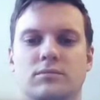
DATASET
Collection of Real and Spoofed Images
1226 Real Images and 7076 Spoofed Images
REAL SPOOF

Slide 18
DATA PREPROCESSING
Image Rescaling: rescale=1./255: This parameter of ImageDataGenerator scales the pixel values of the images to a range between 0 and 1. Rescaling is a common preprocessing step that helps standardize the input data.
Validation Split: validation_split=0.2: The ImageDataGenerator is configured with a validation split of 20%. This means that 20% of the data will be used for validation during training, and the remaining 80% will be used for training the model.
Flow from Directory: flow_from_directory: This method generates batches of augmented data from the specified directory. It automatically infers the classes from the subdirectories and labels the images accordingly.
Target Size and Batch Size: target_size=img_size and batch_size=batch_size: Images are resized to the specified img_size (224x224 pixels in this case) during data loading. Additionally, the data is loaded in batches, and each batch contains batch_size number of samples.

Slide 19
BUILDING THE MODEL
In building a binary classification model for distinguishing between real and spoofed images, a suitable approach is to leverage transfer learning with the MobileNet architecture.
Begin by loading the MobileNet model with pre-trained weights on the ImageNet dataset, effectively utilizing its learned features. Freeze the layers of the MobileNet base to preserve these features and prevent overfitting to the limited binary classification dataset.
Extend the model by adding a Global Average Pooling layer to reduce spatial dimensions and a Dense layer with a sigmoid activation for binary classification.
Compile the model using an optimizer such as Adam and the binary crossentropy loss function.
Finally, train the model on your dataset, incorporating real and spoofed images, and monitor its performance using validation data.

Slide 20
TRAINING AND VALIDATIONS RESULT
Accuracy obtained on Validation Set:
77%

Slide 21
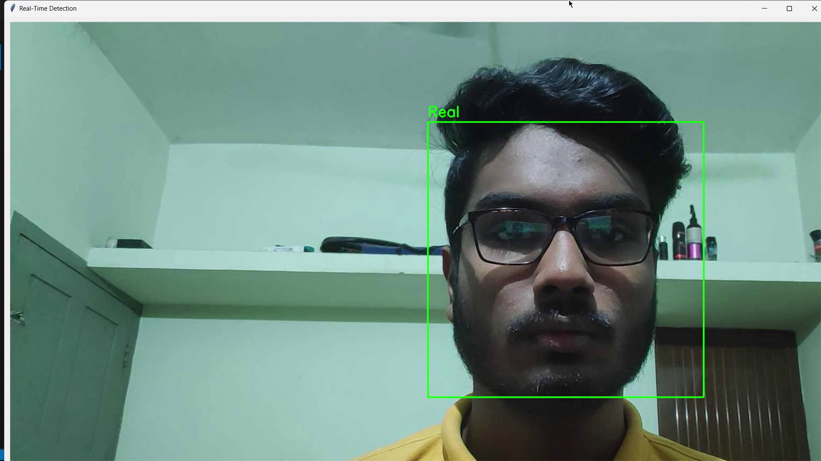
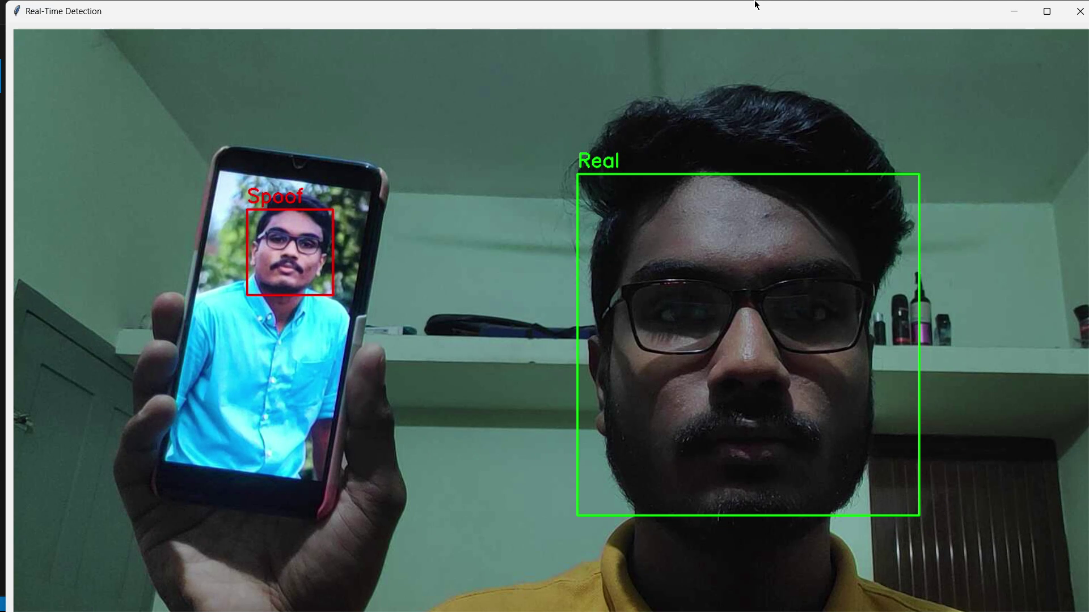
FINAL FACE SPOOFING SAMPLES

Slide 22
THANK YOU

